Slide 1
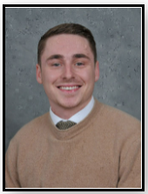
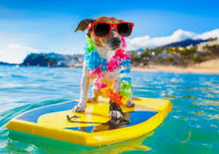
Broadheath Primary School
E
Z
I
N
E
Welcome to the Summer Edition of our magazine.
4WH have been working very hard creating lots of new pages.
It is packed full of fun and interesting topics and activities. So sit back, relax and enjoy!

Slide 2
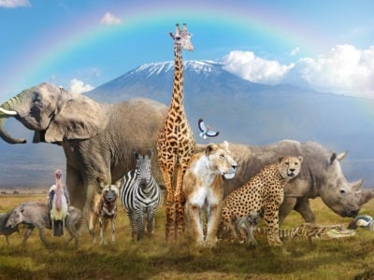
Contents
Teacher in the spotlight
PE challenges
Sports Quiz
Animal Quiz
Year 5 Castle Howard
Summer Holiday ideas

Slide 3
Teacher in the spotlight
What was your favourite subject school?
PE – as I am sure you would have all guessed!
I love all sports and I am super competitive too!
Do you speak any other languages?
Sadly not – I would love to learn Spanish
and would always advise children to learn
a musical instrument whilst still at school and learn a new language!!
What is your favourite sport?
Football; football and more football!
I also love cricket and dodgeball.
What is your favourite food?
I love spicy curries! The hotter the better!
I also like the ‘Hot Honey’ pizza from
Pizza Express – I would highly recommend ;)
maybe that’s the reason I didn’t win my sports day race against Sam?
Mr Bird
What is your favourite film?
A family favourite would have to be
The Lion King…… the Jungle Book is also a classic!
What are you looking forward to in 2022?
I am looking forward to a little more normality and
hopefully the safe easing of covid restrictions
in the near future.
I am also looking forward to seeing my beloved
Nottingham Forest back in the premiership and playing at Etihad stadium – if my memory serves me right;
last time we played there in the FA Cup we won 3-0! :D
Which football team do you support?
Quite simply the greatest football team in Europe – Nottingham Forest FC. I have tried to tempt some Manchester supporters at Broadheath Primary over to NFFC, but so far I haven’t had much luck! I wonder why…..

Slide 4
Speed Bounce Challenge- How many times can you jump over a cone or object (maybe a pair of socks) in 1 minute?
Please ask an adult before trying any of our challenges!
PE Challenges
Click on the videos
and have a go!
Stork balance challenge- How long can you hold the balance for?
Have a go at the PE challenges. Have you got what it takes?
Star jumps Challenge-
How many star jumps can you do in 1 minute?

Slide 5
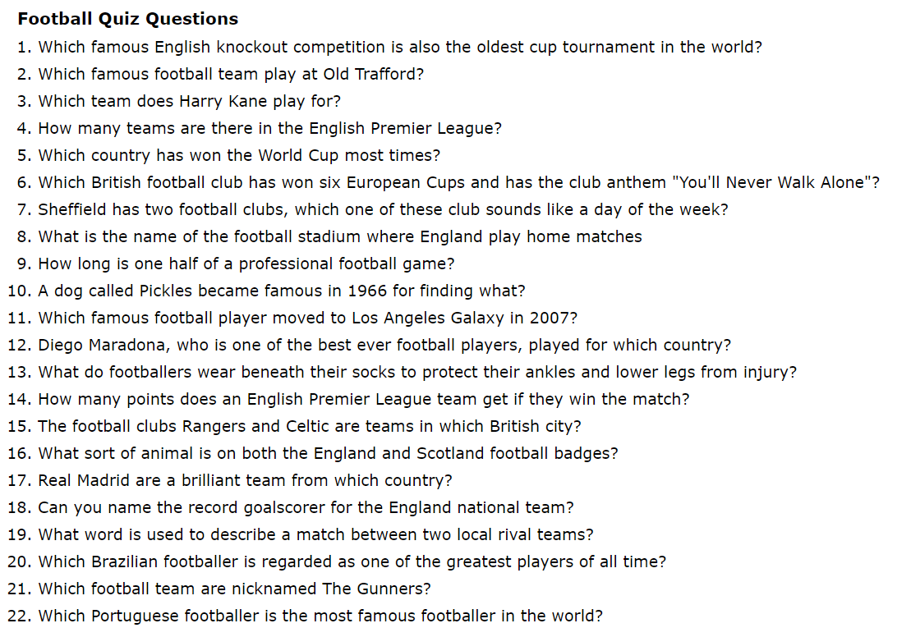
This summer has been a fantastic time for Sport. Have a go at the Football Quiz.
Turn to the next page for the answers……

Slide 6
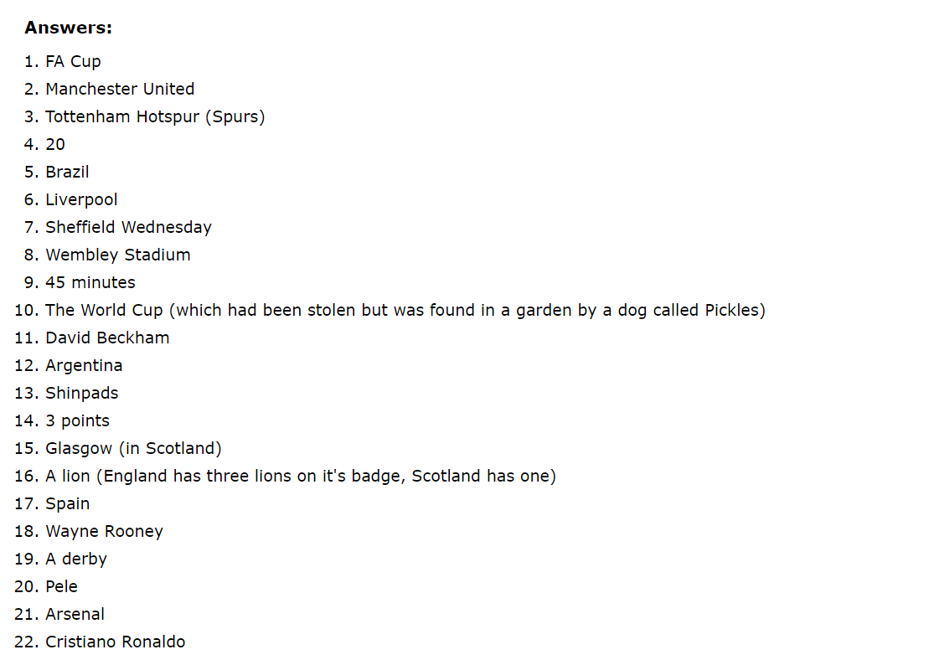
What was your score?

Slide 7
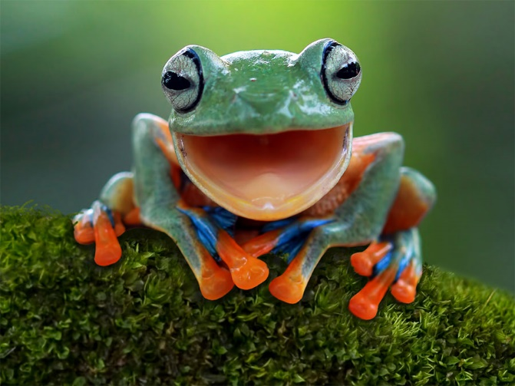
Animals: Always, sometimes or never.
Do you like animals!? Think you can get top marks in this quiz!? Try it out! This quiz has ALL types of animals like birds, fish and land animals. Read on to find out! ☺
Q1) Always, sometimes or never?
Frogs give birth to live young.
Q2) Always, sometimes or never?
A Flamingo is pink.
Q3) Always, sometimes, or never?
A crocodile can stick out its tongue.
By Ayva 4WH

Slide 8
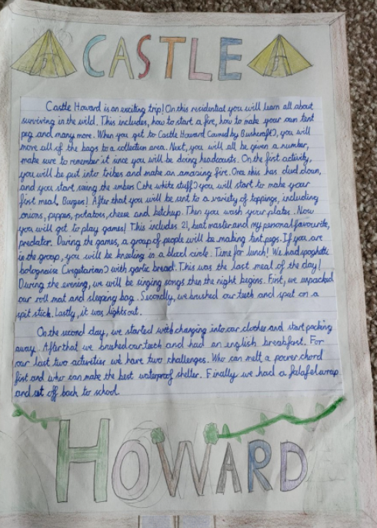
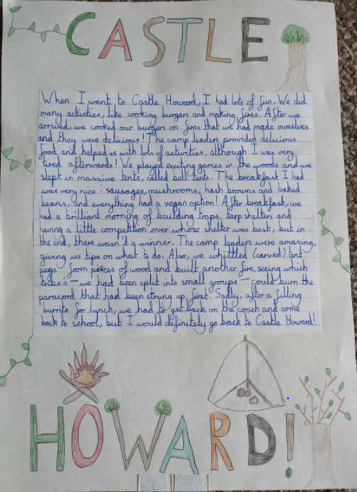
Year 5 visited Castle Howard for their trip.
Here are some of the children’s memories.

Slide 9
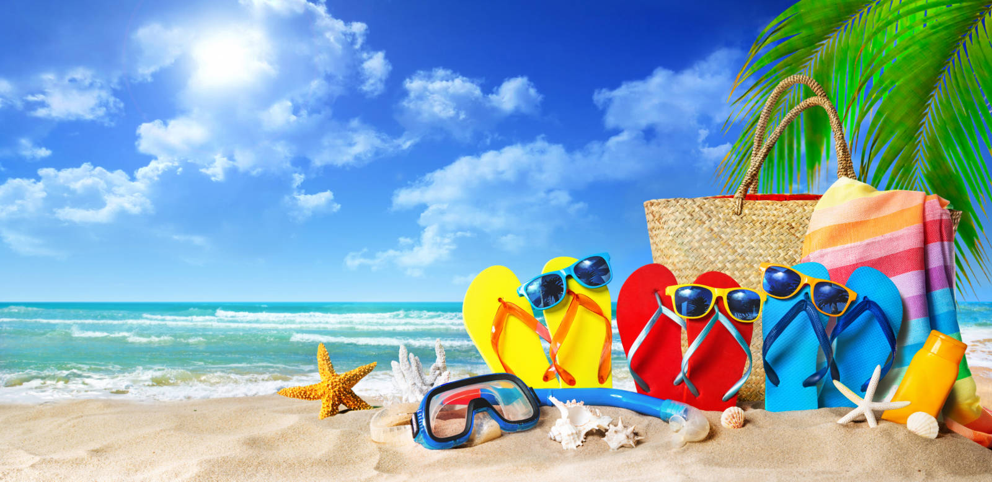
IDEAS FOR A NICE HOLIDAY.
Art: Make a piece of art any style: 6. Dance : make a dance
Bright and exciting Dances from different cultures and different types of music.
Dull and dark
7. Crafts :make something
2. Sports: Do some sports: instruments, junk modelling
Gymnastics
Football
Basketball
Swimming
3. Fort: make a big fort out of
Pillows and blankets.
4. Cook [ask parent for help]
Cook a meal:
Pasta
Rice
Dessert
5. Water: water activities
Water fight
Pool water balloons Have a nice holiday
BY Karma 4WH

Slide 10
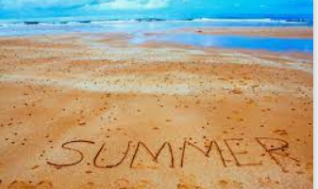
Have a fantastic and safe Summer!
See you all in September.

