Slide 1
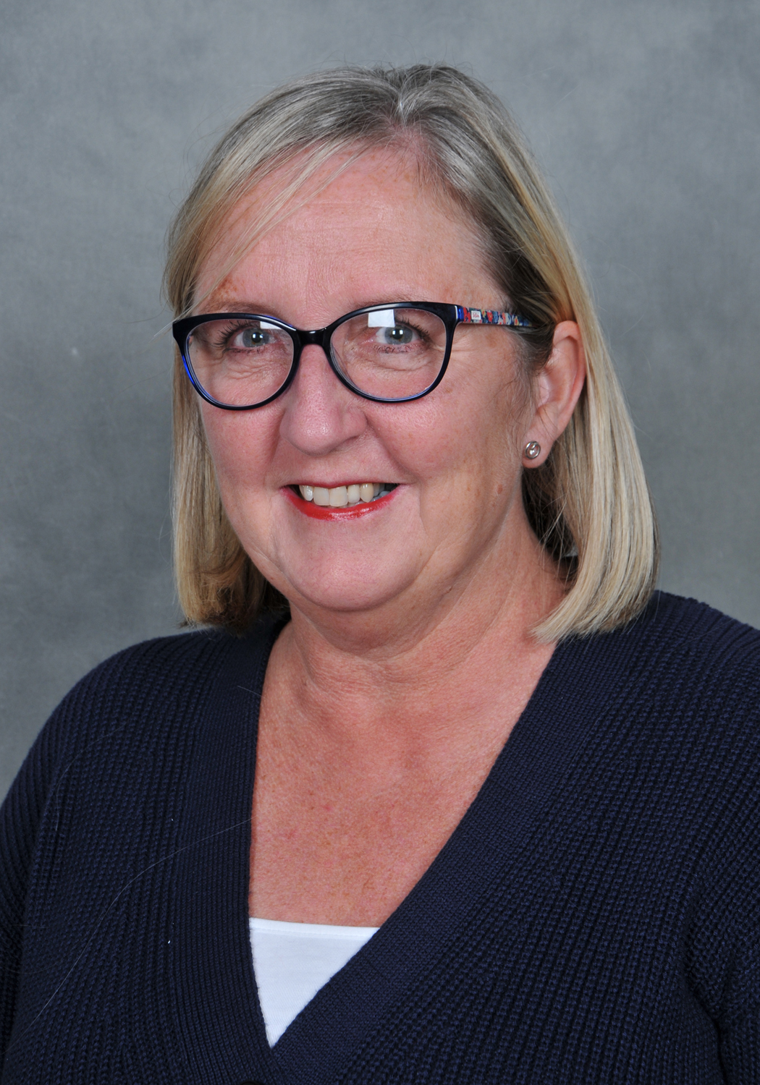
MRS EGAN
SCHOOL BUSINESS MANAGER
Wishing everyone a very warm welcome on behalf of myself and the whole of my team.

Slide 2

THE NEST
(OFFICE/RECEPTION)
Mrs egan, business manager
Mrs evans finance officer, mrs francis and mrs kitchen

Slide 3
SCHOOL UNIFORM – HUGELY PROUD – order before July 15th
AVAILABLE FROM SCHOOL
SCHOOL SUPPLIER(S)
RECEPTION BOOK BAGS
https://gooddies.co.uk/
SELECT BROADHEATH PRIMARY SCHOOL FOR ALL OPTIONS AVAILABLE
MID GREY FOR TROUSERS AND PINAFORES
GREY SOCKS OR TIGHTS
WHITE POLO SHIRTS AVAILABLE IN MOST SUPERMARKETS
PINAFORES PREFERABLE TO AID INDEPENDENCE IN THE BATHROOM
BLACK SCHOOL SHOES, BUCKLED OR WITH VELCRO AGAIN TO AID INDEPENDENCE FOR EARLY YEARS

Slide 4
SCHOOL DROP OFF
TO EASE CONGESTION
You may park in the Bramley Farm car park, please keep to the side that is adjacent to the school field.
Please avoid parking outside our neighbouring properties and please ensure that you never BLOCK a drive way.
The school car parks are for Staff use only.
Should you require assistance due to mobility constraints at any time, please contact our Headteacher so that a Parking Permit could be arranged at her discretion.

Slide 5
SHOULD YOU BE RUNNING LATE FOR PICK UP – YOU HAVE 2 OPTIONS
LATE CLUB
OWLS NEST
Please phone school to inform them you are going to be late for pick up.
Should you simply be running late for up to 10 minutes or so, your child will be registered at late club, this ensures that the children are safe and looked after, so that you do not need to worry.
There is a charge however of £10 per family per whole week, this also benefits parents who are picking up from other schools.
Should you be more than 15 minutes late, your child will be booked in to Owls’ Nest automatically.
You are able to register your child for Owls’ nest last minute for emergencies only. Please register and pay on the Arbor Parent Portal. Booking ahead is always preferable.
During the day, you can phone or email and book in your child, they will receive a cold option for tea.
This facility is payable on the day and is £10

Slide 6



GETTING IN TOUCH
08:40 – 15:45
TELEPONE
EMAIL
IN PERSON - COVID 19 RESTRICTED

Slide 7

IF YOUR CHILD IS UNABLE TO ATTEND SCHOOL …
Dial 0161 928 4748 #1
BEFORE 09:00HRS
PLEASE STATE YOUR CHILD’S FULL NAME
CLASS
REASON FOR THEIR ABSENCE
YOUR NAME AND RELATIONSHIP TO THE CHILD
PLEASE CALL IN EVERY DAY THE CHILD IS ABSENT UNLESS ADVISED OTHERWISE

Slide 8
GDPR
Data protection is of the utmost importance, you will have selected your preferences on our application form. This information must be updated immediately should any of your preferences change for any reason.
Please ensure that you always keep your contact details up to date, this is essential, you can also do this for yourself on the Arbor Parent Portal:-
Email
Telephone / mobile number
Work contact details
Address

Slide 9
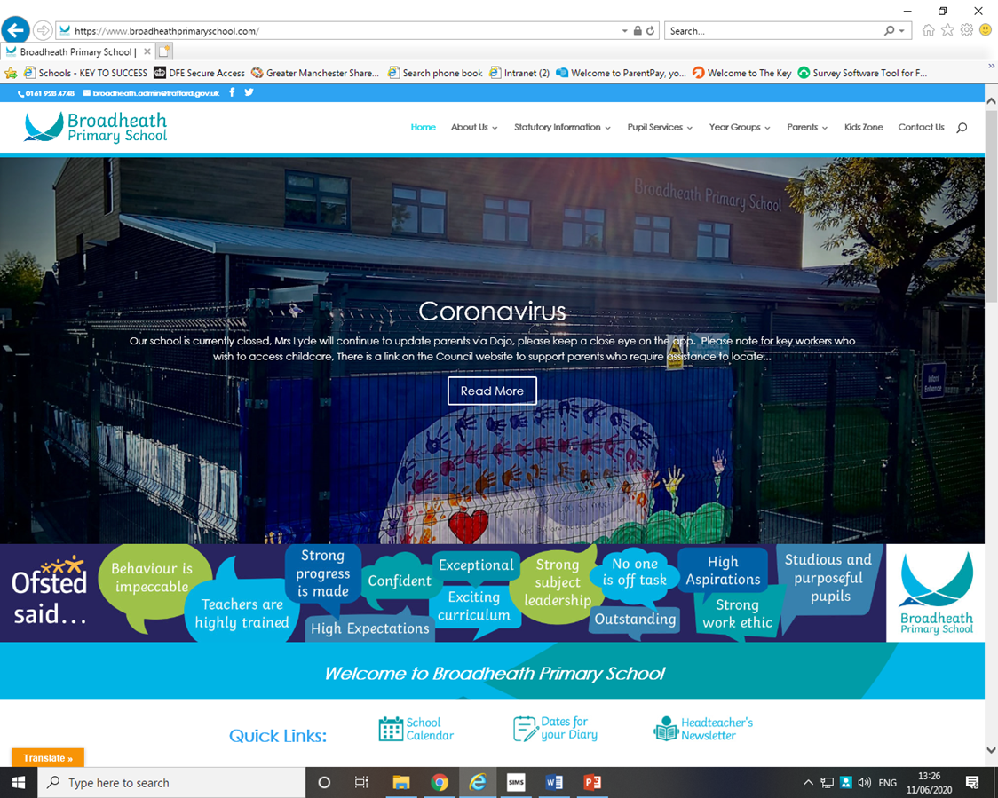
SCHOOL WEBSITE FOR UP TO DATE INFORMATION
USEFUL TABS FOR YOU
HOLDING SCREEN
FRONT PAGE QUICK LINKS
  FOR THE CALENDAR OF EVENTS
  SCHOOL HOLIDAYS
  WRAP AROUND CARE
TABS MOST USED ARE
  STATUTORY INFORMATION
  PARENTS
    MILK AND TOAST
    MEALS TO ORDER
    WALKING BUS

Slide 10

SCHOOL DOJO
Primarily for communications from your child’s teacher to ‘home’ with information that directly relates to your child.
Whole of school messages from the Head Teacher or Deputy
Year Group messages as appropriate

Slide 11
Snacks and Meals – Named water bottles must be provided for each child
SNACKS
SCHOOL MEALS
One portion of fresh fruit is available for all Key Stage One children. Nursery, Reception, Years one and two every day.
Milk is provided up until their 5th Birthday, should you wish to continue, you may order milk online for your child via Cool Milk. This can only be done at the beginning of each half term
Toast can be ordered via the Arbor system, this must be completed before the first week of each term.
Menus are designed by Trafford
We have cooks on site, preparing fresh food each day.
All meals must be ordered by the Sunday for the following week.
Packed lunches are also available to choose within the universal school meal option for key stage one children.
Nursery full time places, must provide their own packed lunch.

Slide 12

ARBOR PARENT PORTAL
All parents/carers must register on the Arbor Parent Portal.
You will receive an invite from Arbor, the children are linked for ease of access when there are siblings, plus detailed instructions.
All food allergens along with religious or dietary preferences must also be recorded. This is the Parent/Carers responsibility
You can book hot or cold meals for the week ahead each Sunday, or if your prefer you can simply order for the whole of the half term.
Please ensure you cancel meals for your child should they be off school for any reason prior to 9:00hrs each day they are away.
The on line system is also used to pay for activity within school as much as possible to ultimately achieve a cash less process.
On occasion you may receive a message to inform you that a particular activity is available to pay for. Please enable push notifications.

Slide 13

WRAP AROUND CARE
(PARENTS TAB V AFTER SCHOOL CLUBS)
EARLY BIRDS £4 PER SESSION
OWLS’ NEST £10 PER SESSION
07:30 to 08:55
Breakfast club with continental breakfast (arrival up to 8:30 for access to breakfast), including arts, crafts, a whole range of exciting sports to perfect and/or learn.
Please ask for a pack from the Main Reception or download from our web site for all the details along with the terms and conditions of use.
15:20 to 18:00
Our very own, home from home style after school club
Please ask for a pack from the Main Reception or download from our web site for all of the details along with the terms and conditions of use.

Slide 14





EXTRA CURRICULAR
From 3:20 TO 4:30
A whole range of activities are available, please see the extra curricular activities, details available on our web site – front page
All activities are reviewed each term
Activities payable as per the instruction detailed, please note terms of payment vary as we also utilise external specialist coaches to support our children

